Slide 1
Cross Platform Mobile Programming IF733
Authentication
Andre Rusli
Notes:
Module 114-115 for auth service and guards
Module 128 for ion-label and ion-item

Slide 2
Agenda
How authentication works
Using Firebase Authentication

Slide 3
How Authentication Works
1/2

Slide 4
How Authentication Works
Token
Ionic
App
Auth Data
Server
Response
Token
Session
Response

Slide 5
Firebase Auth
2/2

Slide 6
Initial Setup

Slide 7
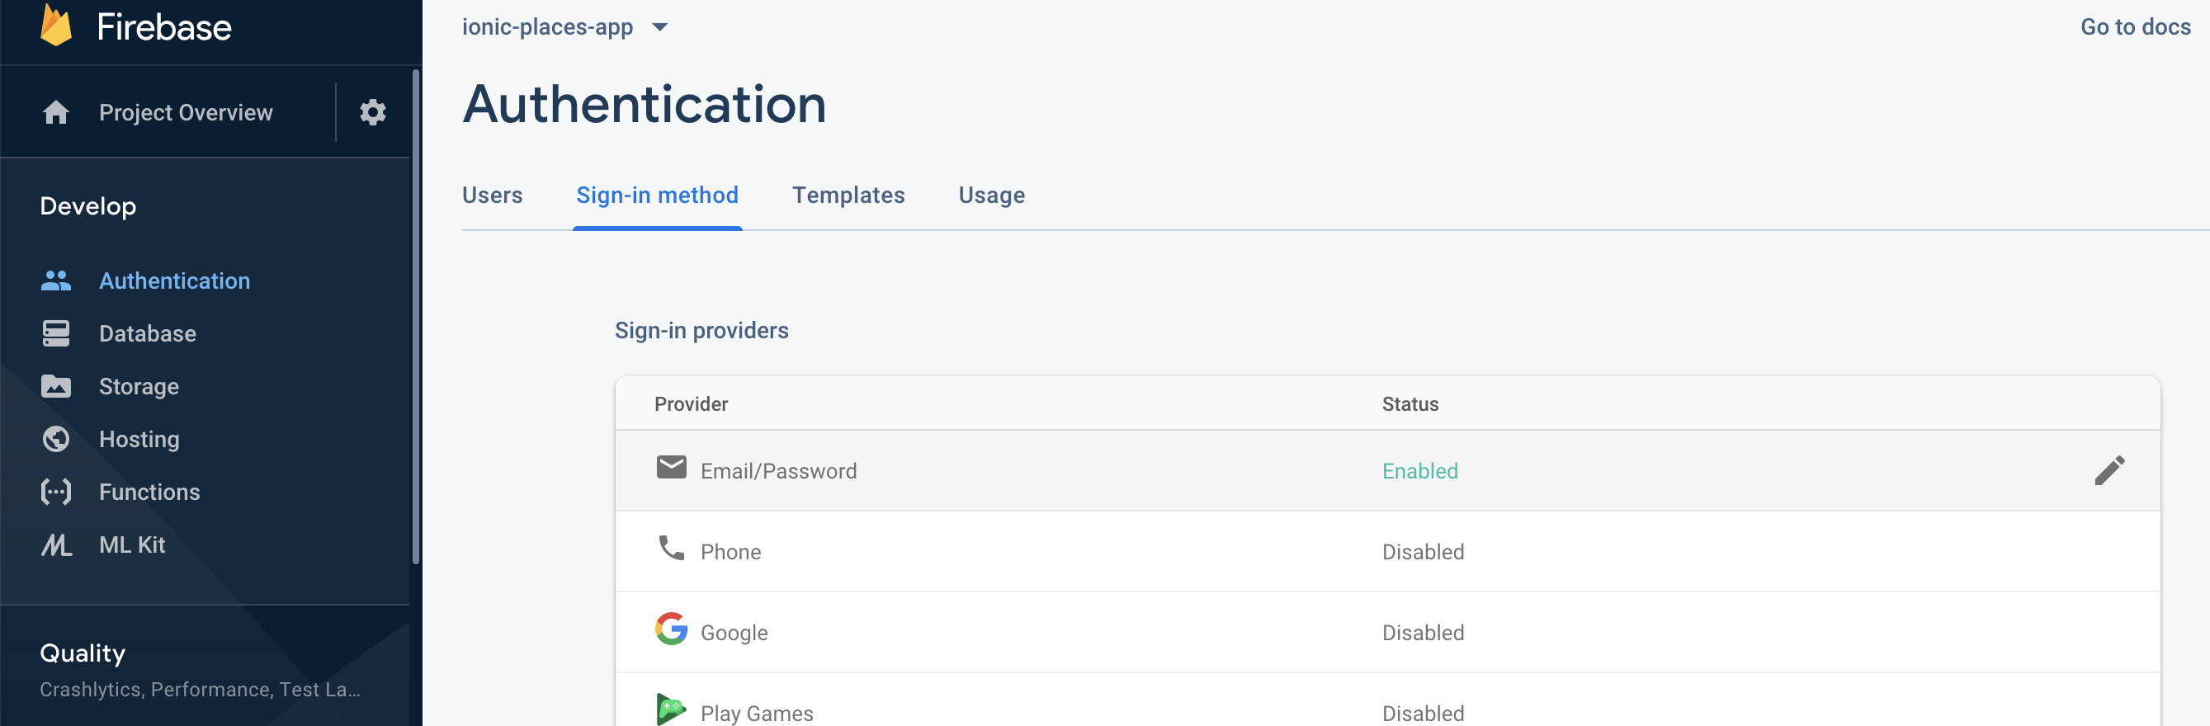
Enabling Email/Password Sign-in Method

Slide 8
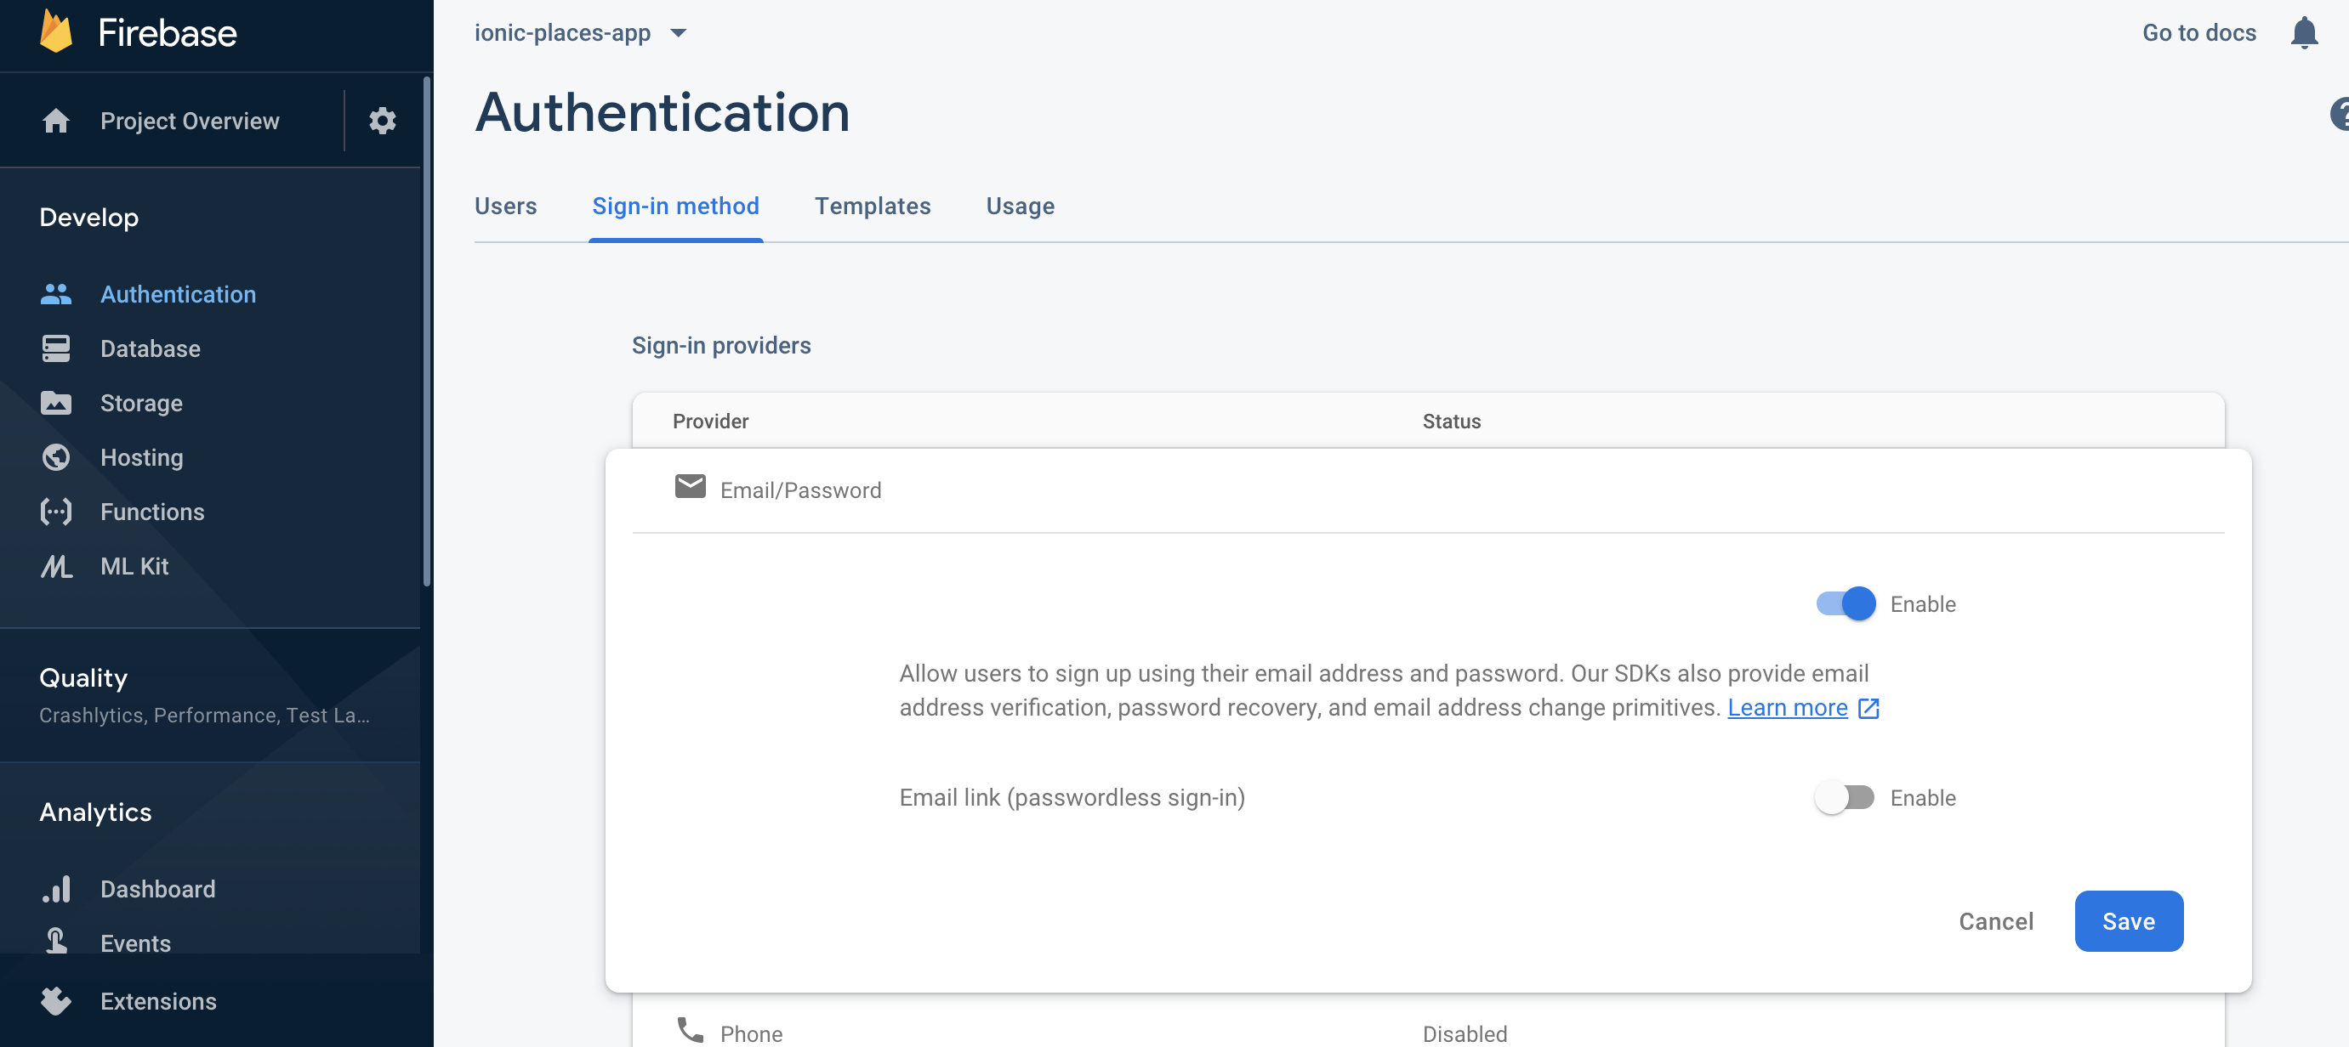
Enabling Email/Password Sign-in Method
Notes:
https://firebase.google.com/docs/reference/rest/auth

Slide 9
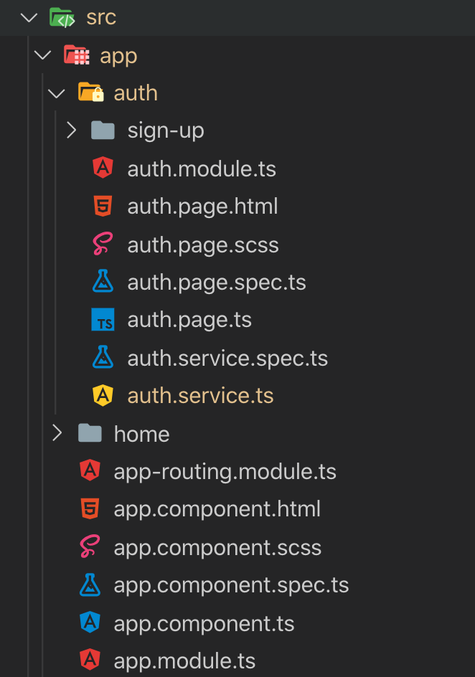
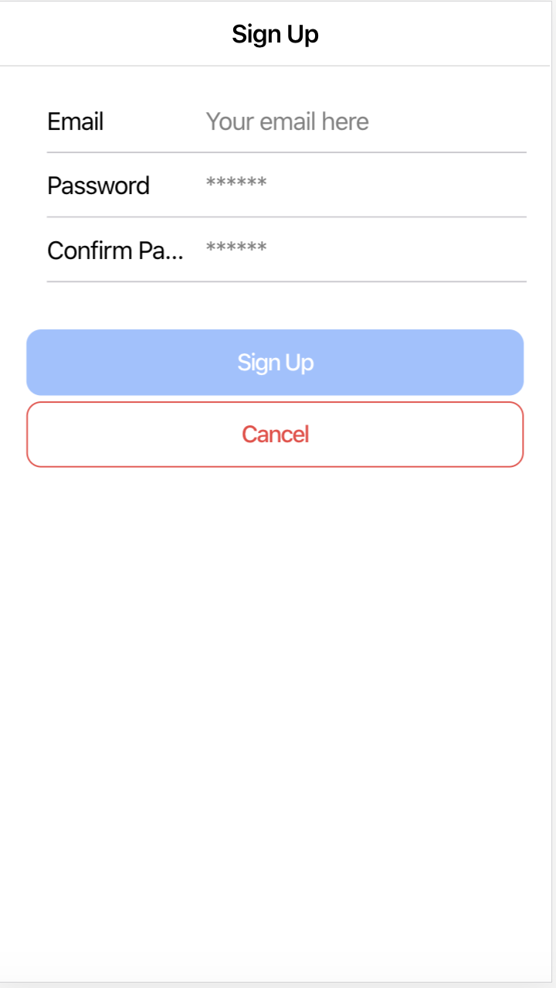
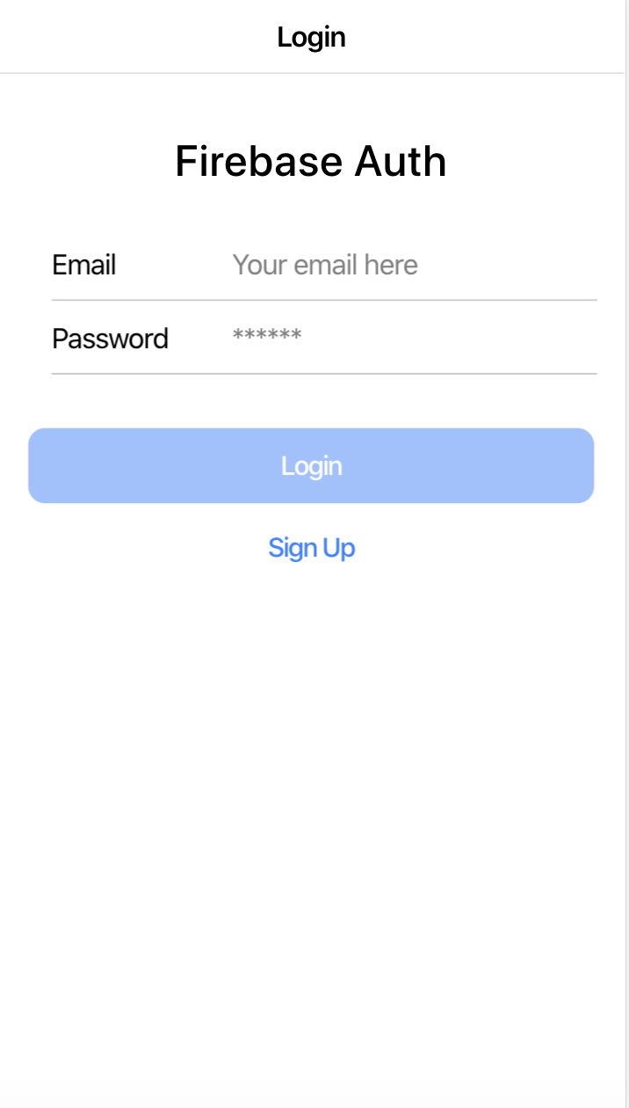
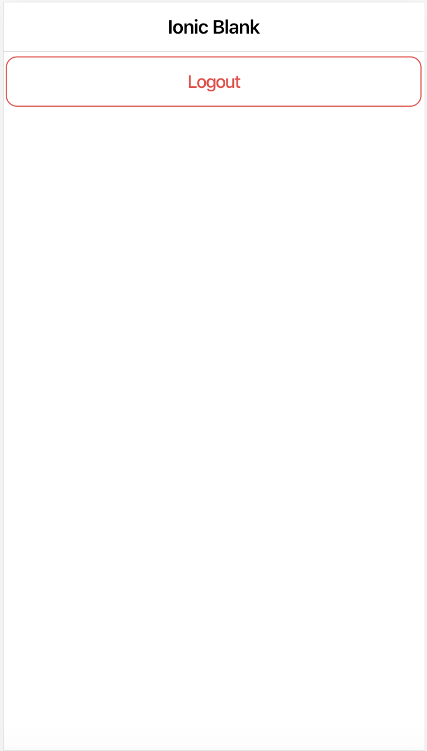
Preparing Our Authentication Components
Notes:
https://github.com/arusl/ionic-firebase-auth.git

Slide 10
Sign Up

Slide 11
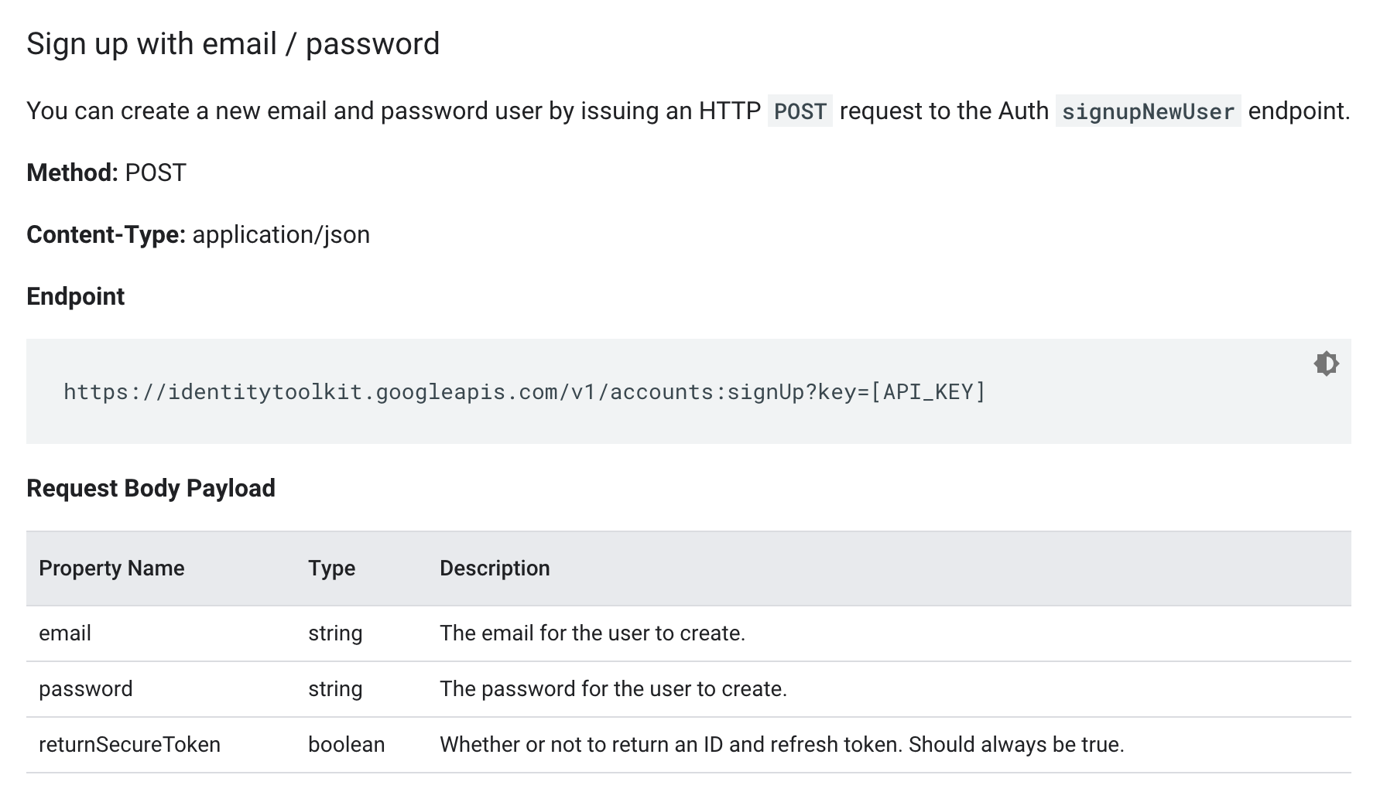
Sign Up w/ Email and Password Firebase Rest API
Notes:
https://firebase.google.com/docs/reference/rest/auth

Slide 12
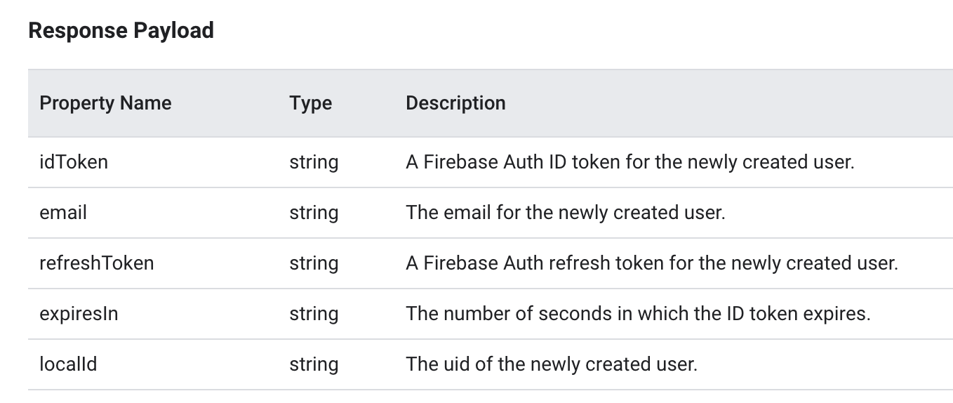
Sign Up w/ Email and Password Firebase Rest API
Notes:
https://firebase.google.com/docs/reference/rest/auth

Slide 13
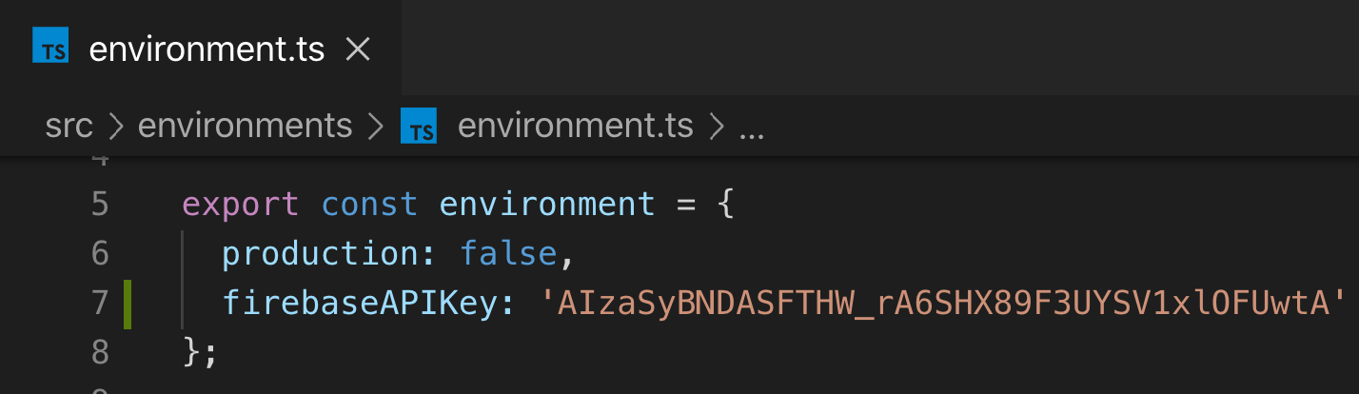
Auth Service -Sign Up-
auth.service.ts
export class AuthService {
isAuthenticated = false;
constructor(private http: HttpClient) { }
signup(email: string, password: string) {
//firebase signup API here
this.http.post(
`https://identitytoolkit.googleapis.com/v1/accounts:signUp?key=${environment.firebaseAPIKey}`,
{
email,
password,
returnSecureToken: true
}
);
}
Notes:
Don’t forget to add HttpClientModule in app.module.ts. Imported from @angular/common/http.

Slide 14
Auth Service -Sign Up-
interface AuthResponseData {
kind: string;
idToken: string;
email: string;
refreshToken: string;
localId: string;
expiresIn: string;
registered?: boolean;
}
export class AuthService {
isAuthenticated = false;
userId = null;
constructor(private http: HttpClient) { }
signup(email: string, password: string) {
//firebase signup API here
return this.http.post<AuthResponseData>(
`https://identitytoolkit.googleapis.com/v1/accounts:signUp?key=${environment.firebaseAPIKey}`,
{
email,
password,
returnSecureToken: true
}
);
}
auth.service.ts
Notes:
Don’t forget to add HttpClientModule in app.module.ts. Imported from @angular/common/http.

Slide 15
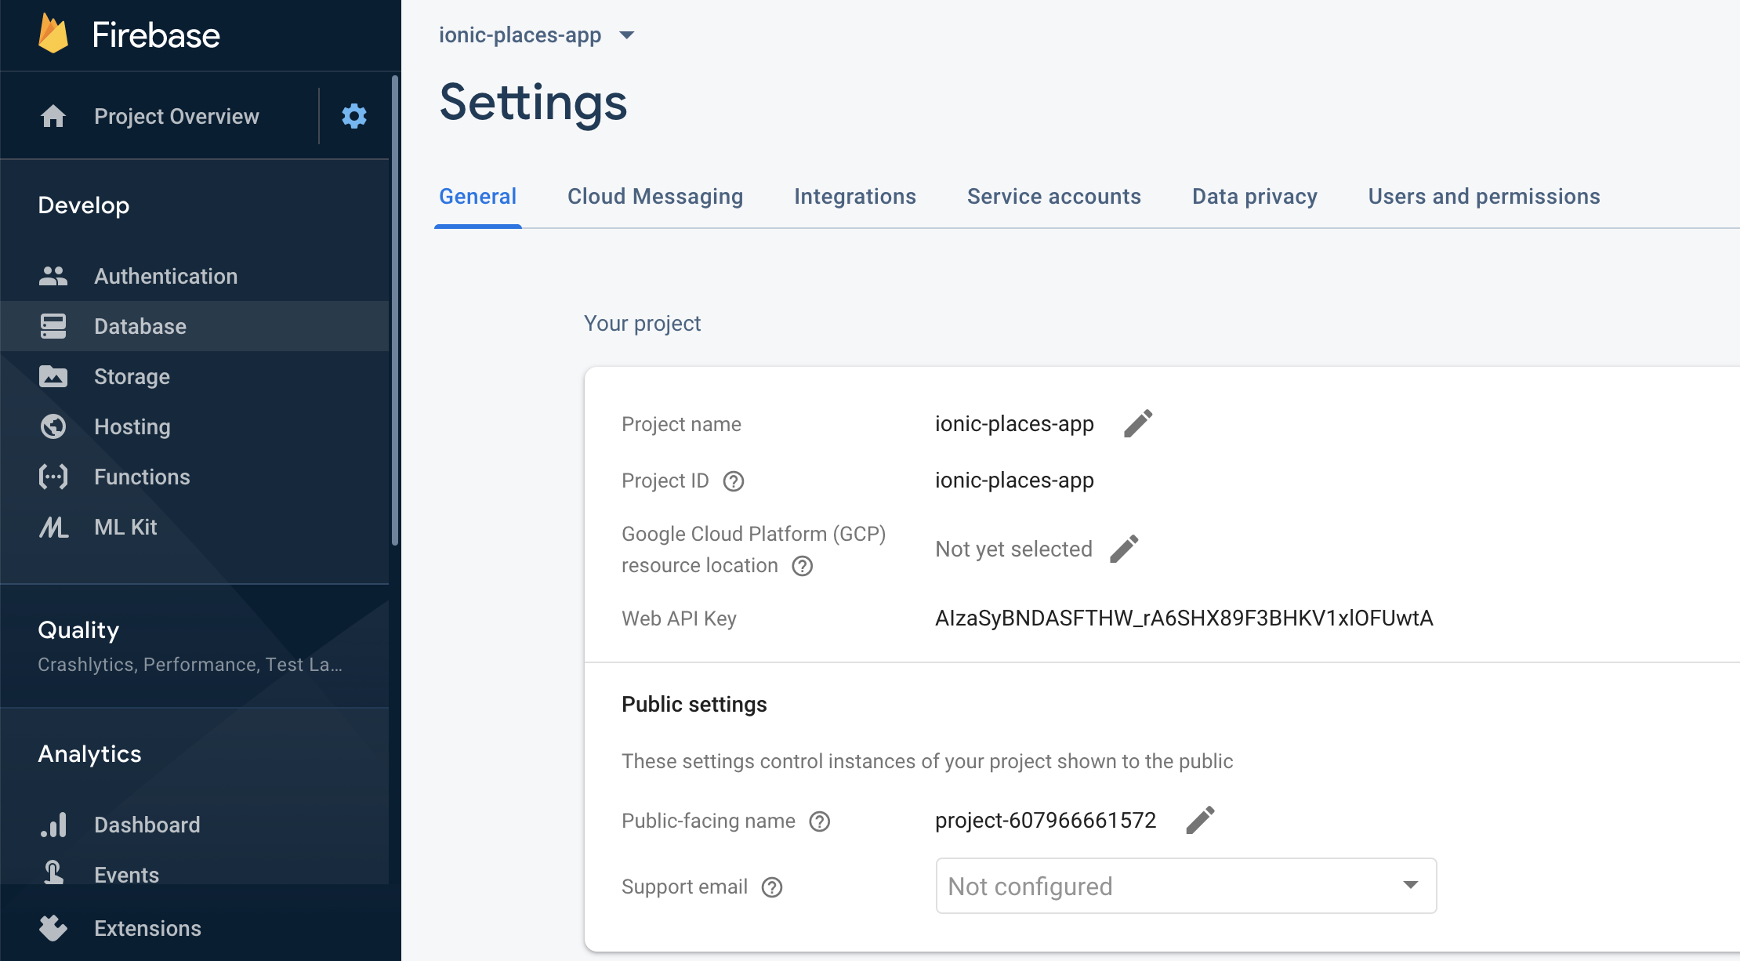

Slide 16
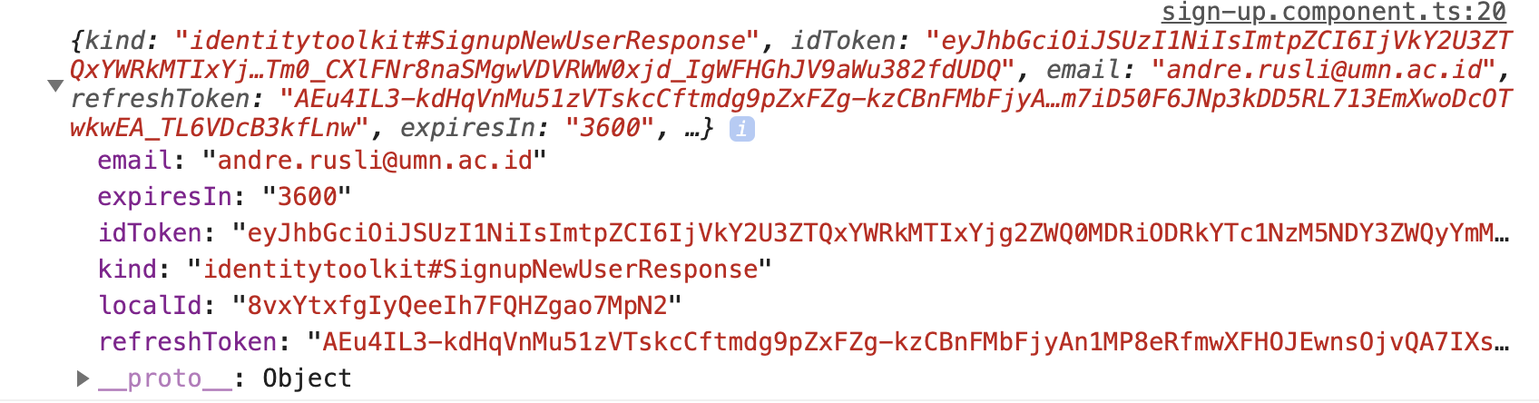
Sign Up Component
auth.page.ts
onSignUp(f: NgForm) {
console.log(f.value);
this.authSvc.signup(f.value.email, f.value.pwd).subscribe(resp => {
console.log(resp);
});
}
Notes:
Don’t forget to add HttpClientModule in app.module.ts. Imported from @angular/common/http.

Slide 17
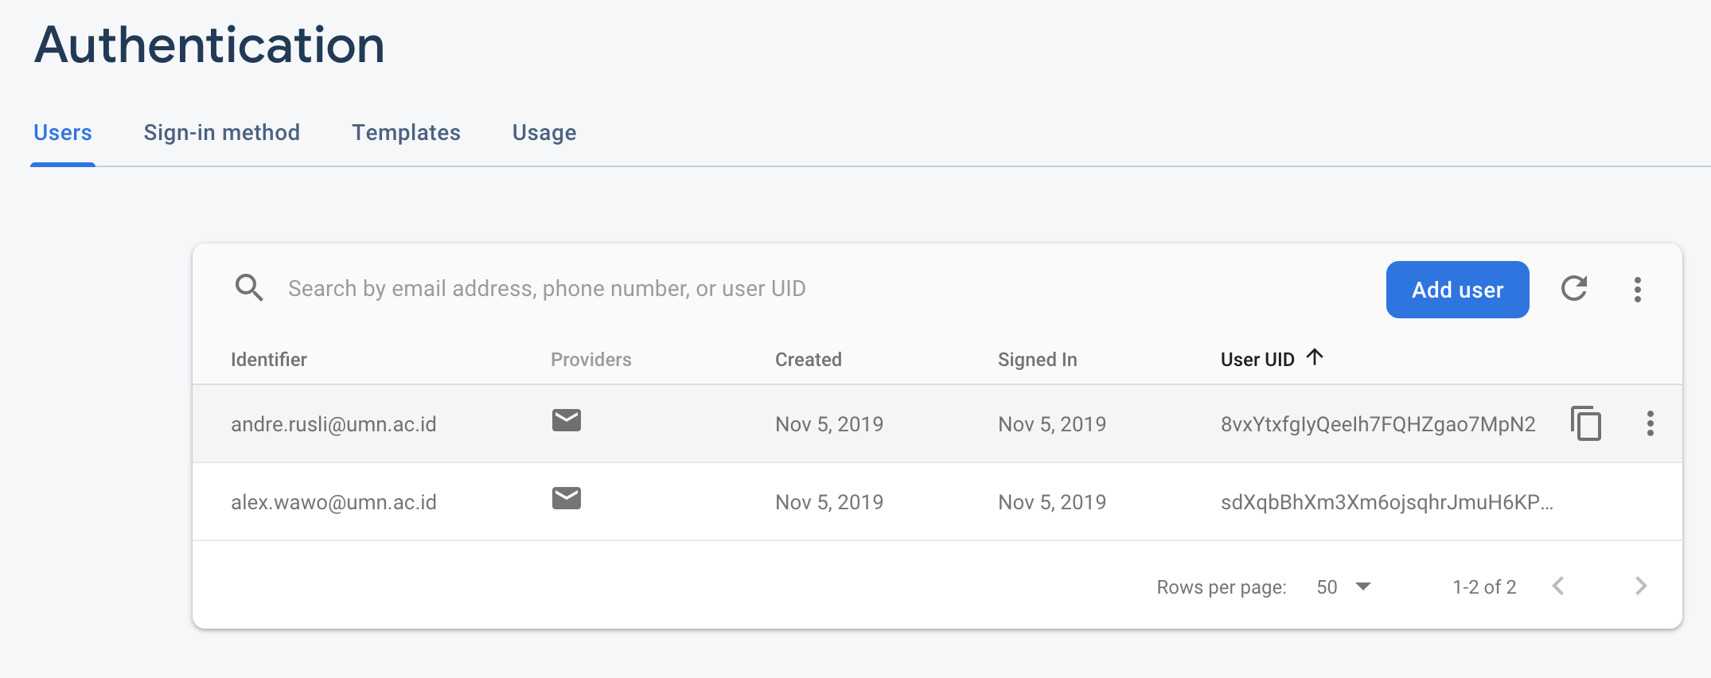
Auth Data in Firebase

Slide 18
User Login

Slide 19
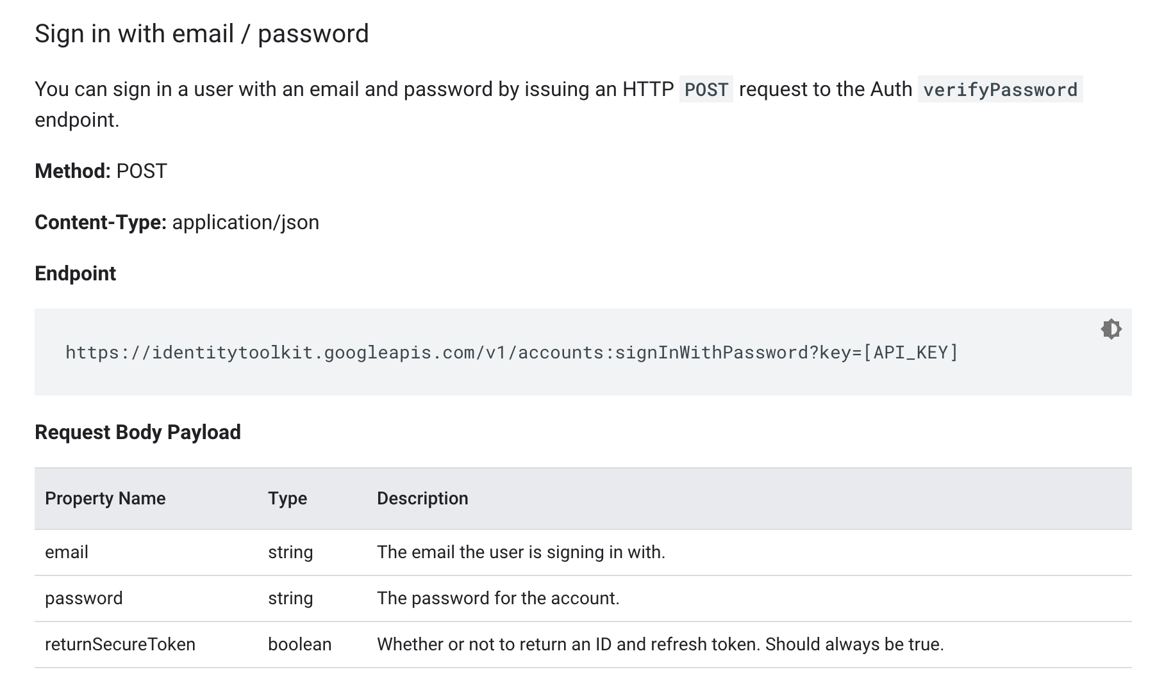
Login w/ Email and Password Firebase Rest API
Notes:
https://firebase.google.com/docs/reference/rest/auth

Slide 20
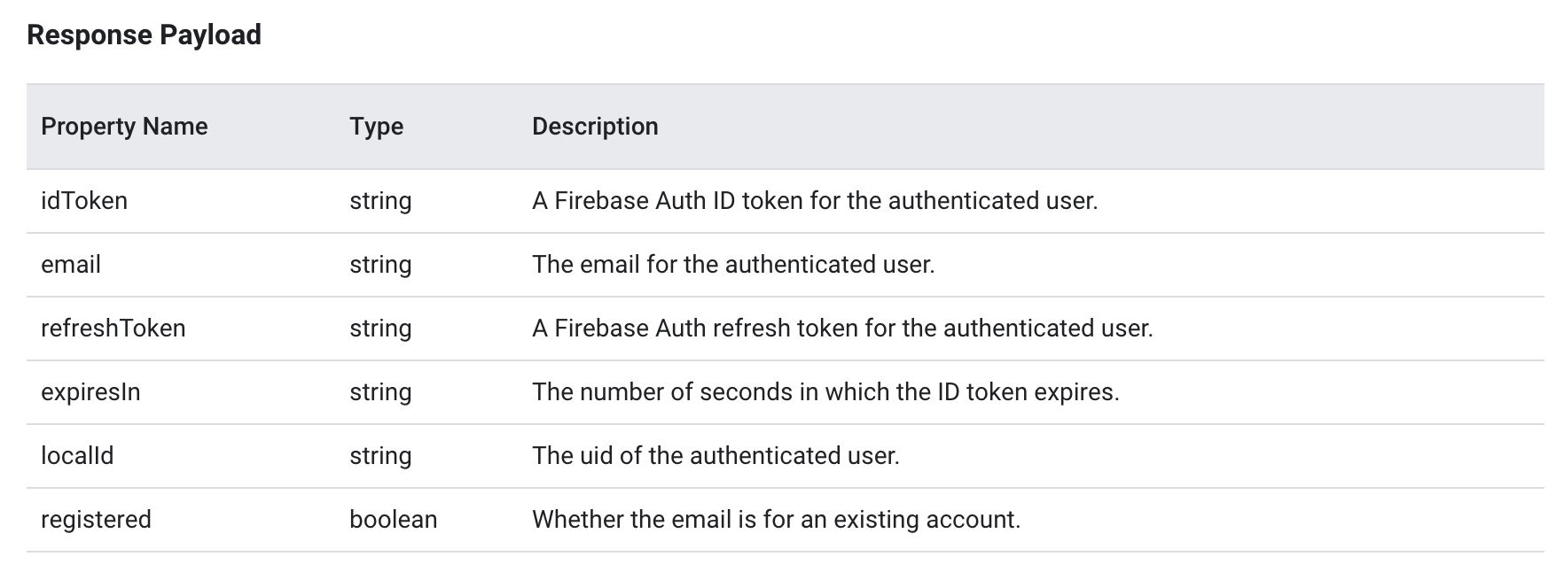
Login w/ Email and Password Firebase Rest API
Notes:
https://firebase.google.com/docs/reference/rest/auth

Slide 21
Auth Service -Login-
auth.service.ts
setUser(userId: string) {
this.userId = userId;
this.isAuthenticated = true;
}
login(email: string, password: string) {
//firebase login API here
return this.http.post<AuthResponseData>(`https://identitytoolkit.googleapis.com/v1/accounts:signInWithPassword?key=${environment.firebaseAPIKey}`,
{
email,
password,
returnSecureToken: true,
});
}
Notes:
Don’t forget to add HttpClientModule in app.module.ts. Imported from @angular/common/http.

Slide 22
Auth Component -Login-
auth.page.ts
onLogin(f: NgForm) {
this.authSvc.login(f.value.email, f.value.pwd).subscribe(
resp => {
if (resp.idToken) {
console.log(resp);
this.router.navigateByUrl('/home');
} else {
console.log('login failed.');
}
},
errorResp => {
console.log(errorResp);
});
}

Slide 23
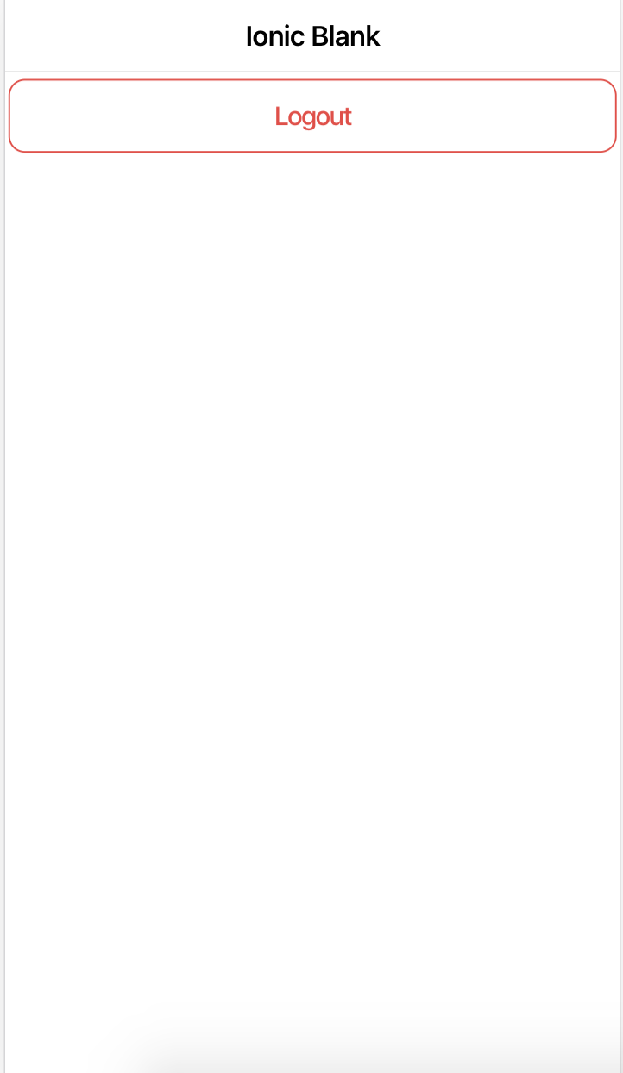
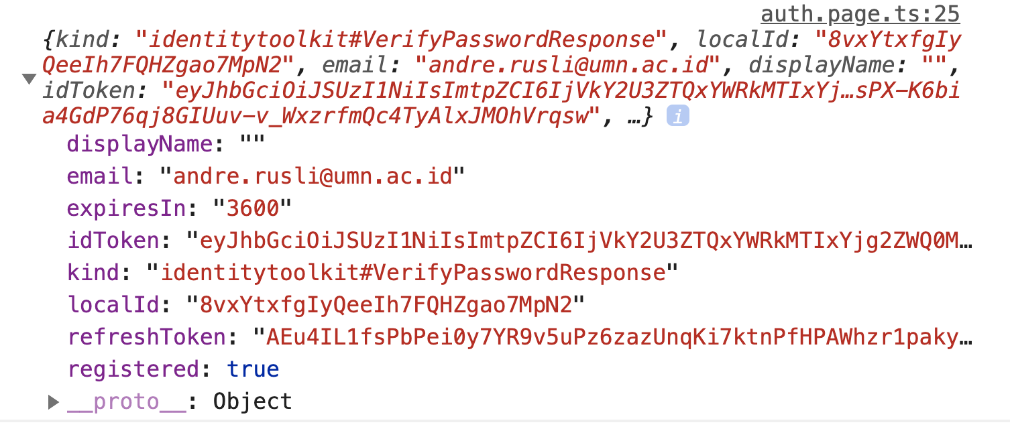
Auth Component

Slide 24
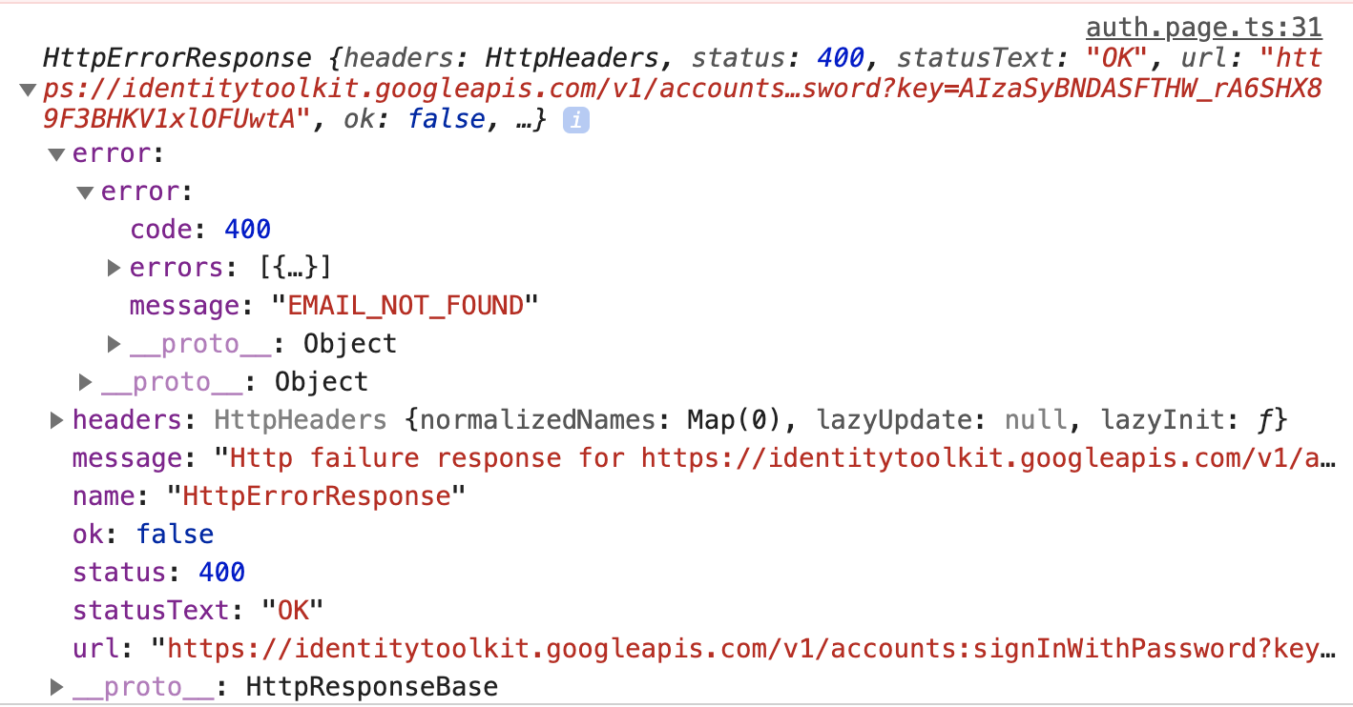
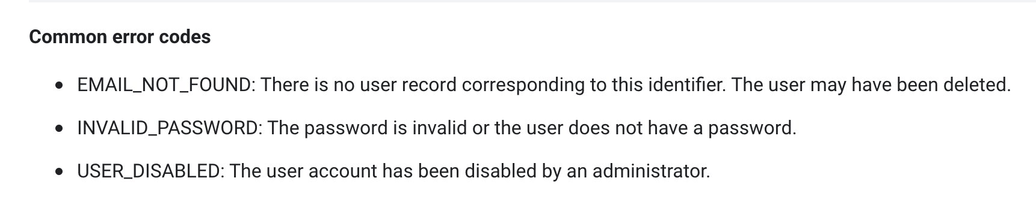
Error Response
Notes:
Don’t forget to add HttpClientModule in app.module.ts. Imported from @angular/common/http.

Slide 25
Manage Current User

Slide 26
Managing User with Subject -user model-
user.model.ts
export class User {
constructor(
public id: string,
public email: string,
private _token: string,
private tokenExpirationDate: Date,
) { }
get token() {
if (!this.tokenExpirationDate || this.tokenExpirationDate <= new Date()) {
return null;
}
return this._token;
}
}

Slide 27
Auth Service -Check if user authenticated-
auth.service.ts
export class AuthService {
private _user = new BehaviorSubject<User>(null);
constructor(private http: HttpClient) { }
get isAuthenticated() {
return this._user.asObservable().pipe(map(user => {
if (user) {
return !!user.token;
} else {
return null;
}
}));
}

Slide 28
Auth Page -Check if user authenticated-
auth.page.ts
ngOnInit() {
this.authSvc.isAuthenticated.subscribe(resp => {
if (resp) {
console.log('User is authenticated');
this.router.navigateByUrl('/home');
} else {
console.log('No user');
}
});
}

Slide 29
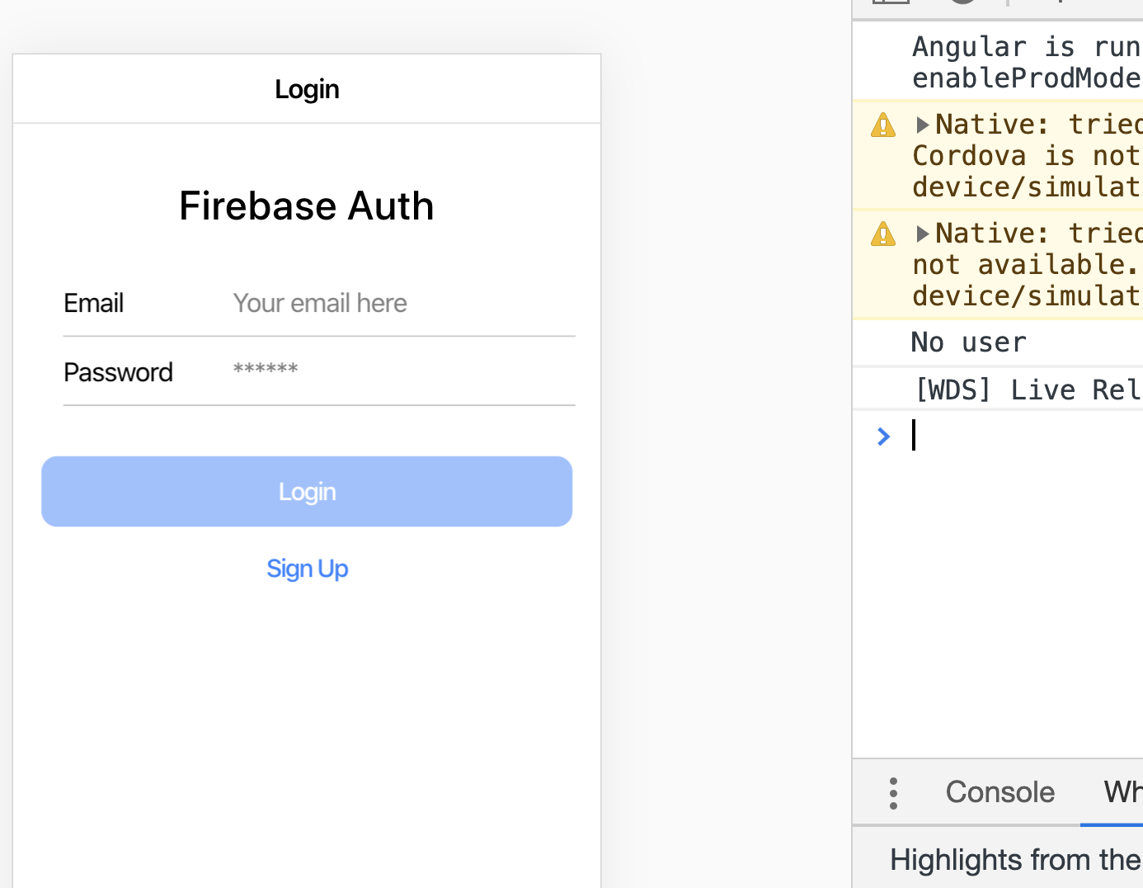

Slide 30
Auth Service -Set user on sign up-
auth.service.ts
signup(email: string, password: string) {
//firebase signup API here
return this.http.post<AuthResponseData>(
`https://identitytoolkit.googleapis.com/v1/accounts:signUp?key=${environment.firebaseAPIKey}`,
{
email,
password,
returnSecureToken: true
}
).pipe(
tap(userData => {
const expTime = new Date(new Date().getTime() + (+userData.expiresIn * 1000));
this._user.next(new User(userData.localId, userData.email, userData.idToken, expTime));
})
);
}

Slide 31
Sign Up Component
sign-up.component.ts
onSignUp(f: NgForm) {
console.log(f.value);
this.authSvc.signup(f.value.email, f.value.pwd).subscribe(resp => {
console.log(resp);
this.modalCtrl.dismiss();
});
}

Slide 32
Notes:
Auth page without user

Slide 33
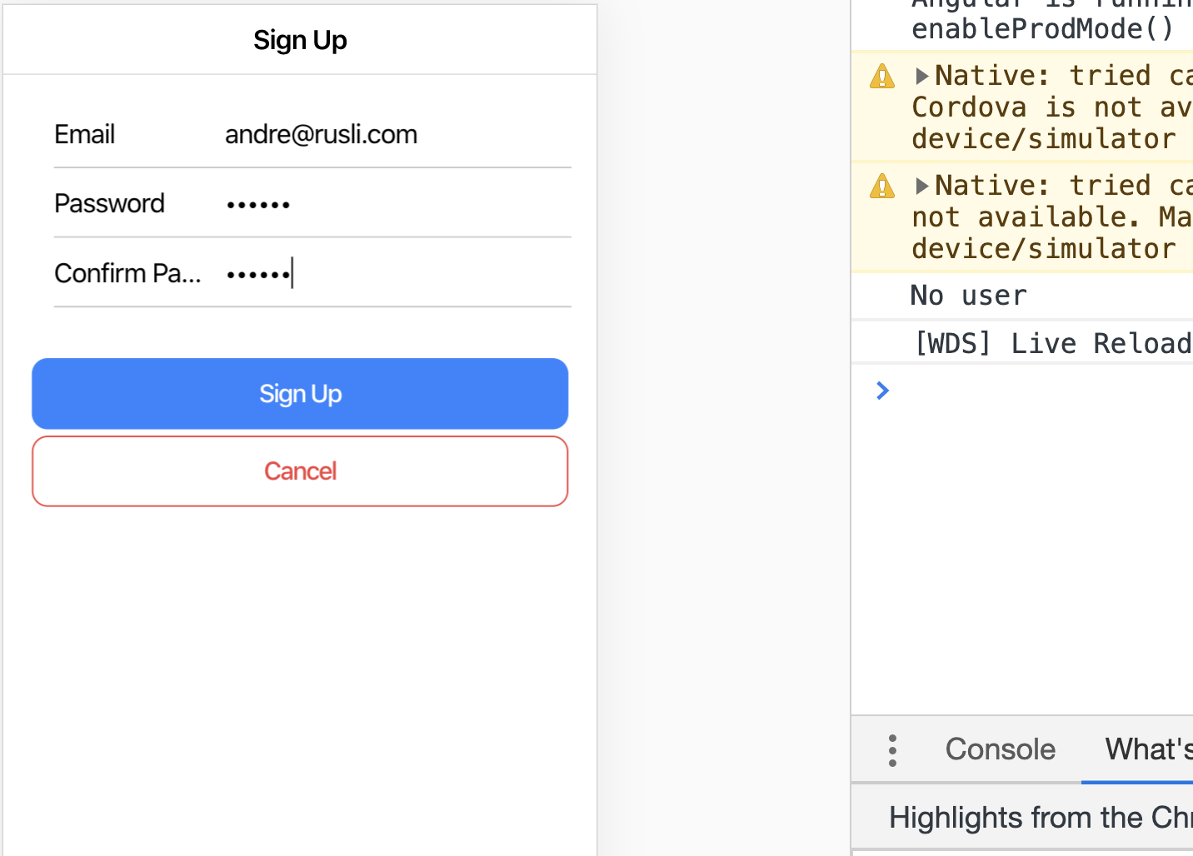
Notes:
User sign up (or sign in)

Slide 34
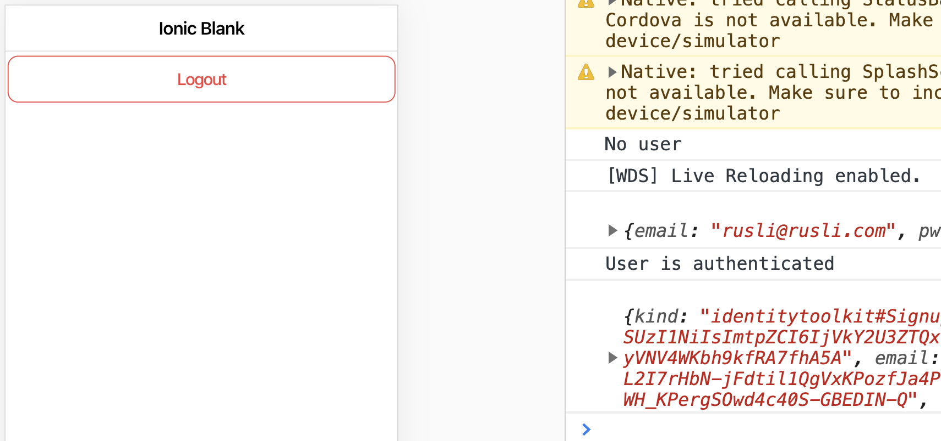
Notes:
User token is saved in the service, then the app automatically redirects to home page because the user is authenticated

Slide 35
Logging out

Slide 36
Logout User
auth.service.ts
logout() {
//firebase logout API here
this._user.next(null);
}
home.page.ts
onLogout() {
this.authSvc.logout();
this.router.navigateByUrl('/auth');
}

Slide 37
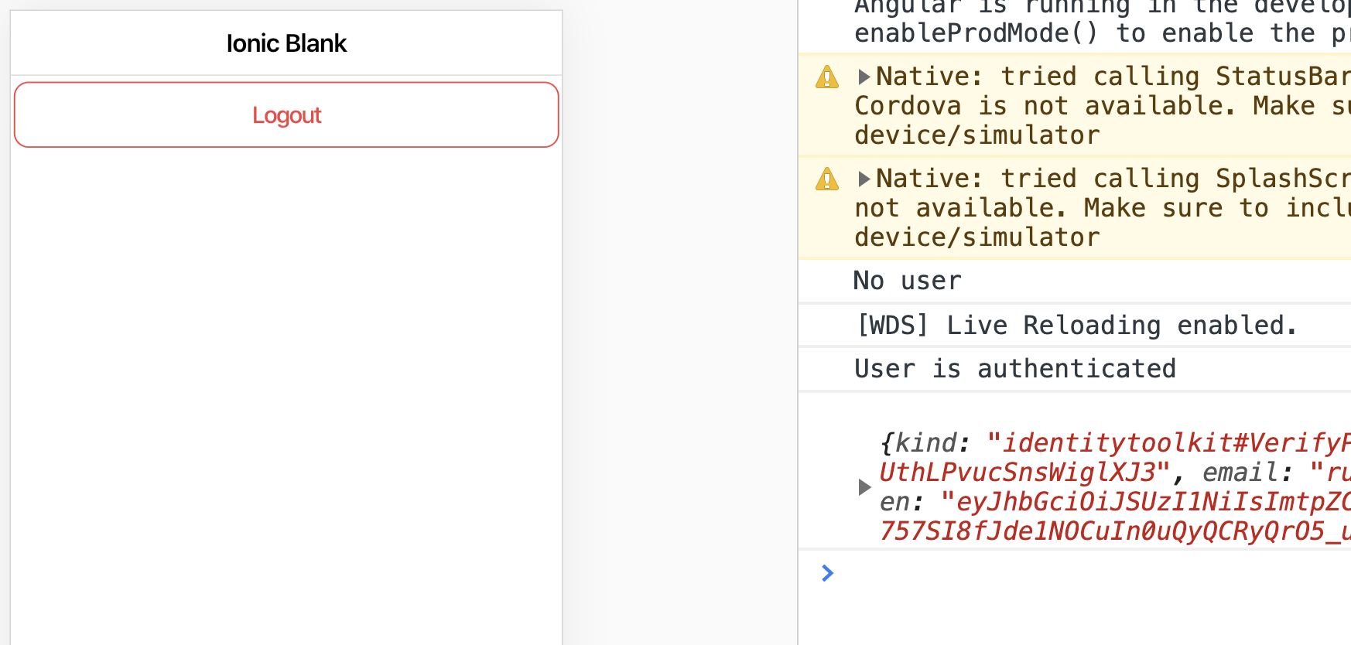
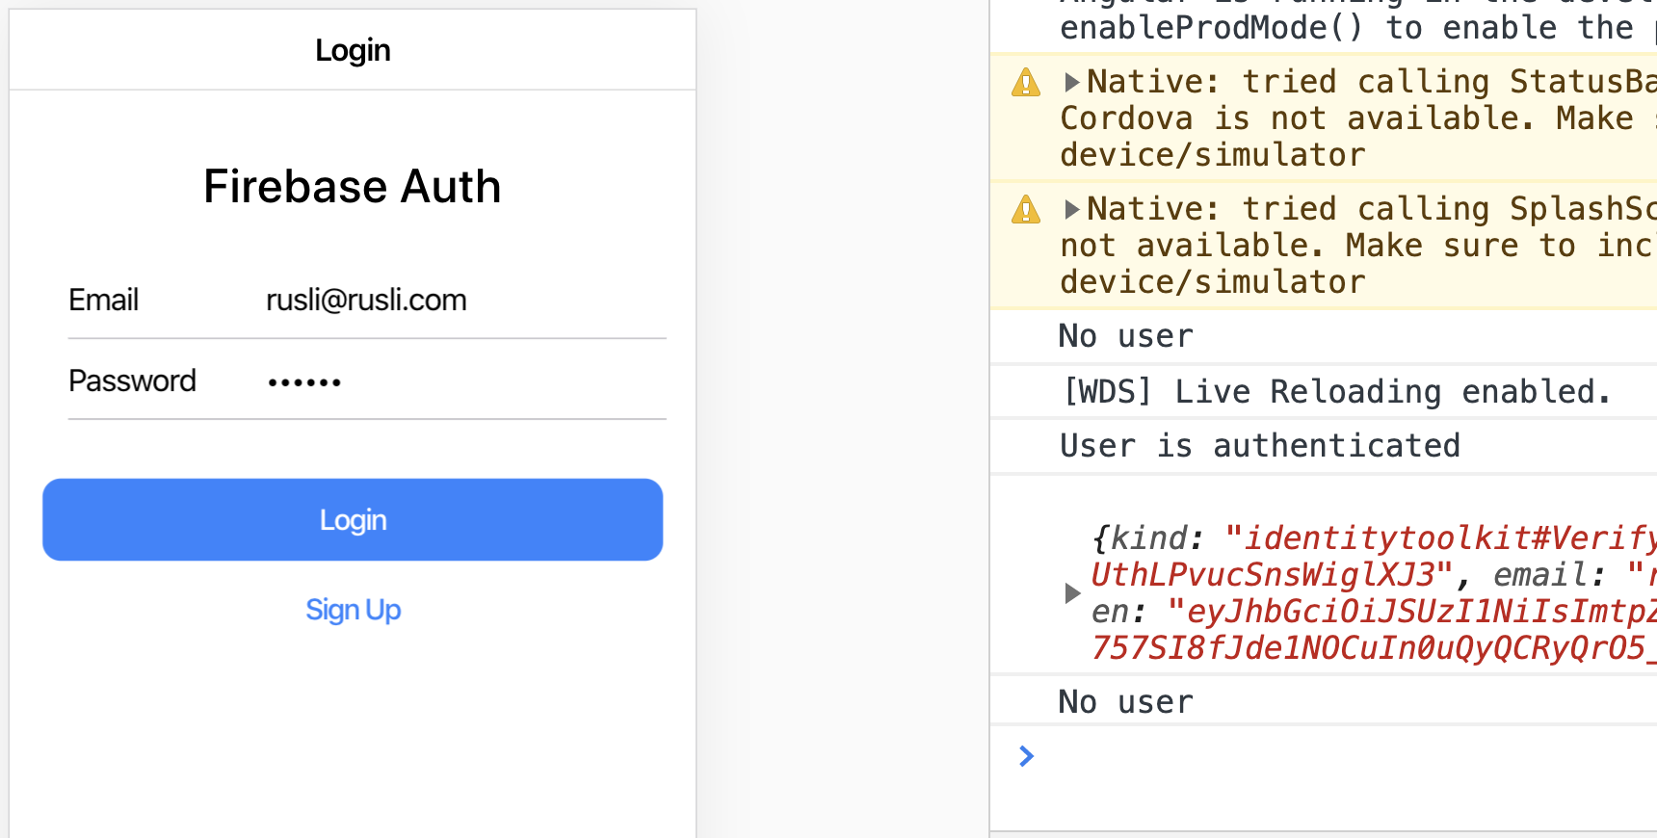
After login, before logout.
After logout, the No User message is shown because the user is null.

Slide 38
Questions?
Comments?

Slide 39
Thank you

